Slide 1
Nature-Inspired CNN Optimization
Group members:
15140094 Mohsin Ashraf
14140062 Mushood Hanif
15140107 Mehvish Hameed
14140044 Rida Yaqoob
Supervisor – Syed Qamar Askari

Slide 2
Overview
Problem Statement
CNNs
Evolutionary Algorithms
Literature Review
Our Work
Benchmarks
References
Scope
Work-breakdown Structure
Learning outcomes

Slide 3
Problem Statement
Optimizing CNN Architecture by tuning it’s parameters using evolutionary or swarm-based algorithms.

Slide 4
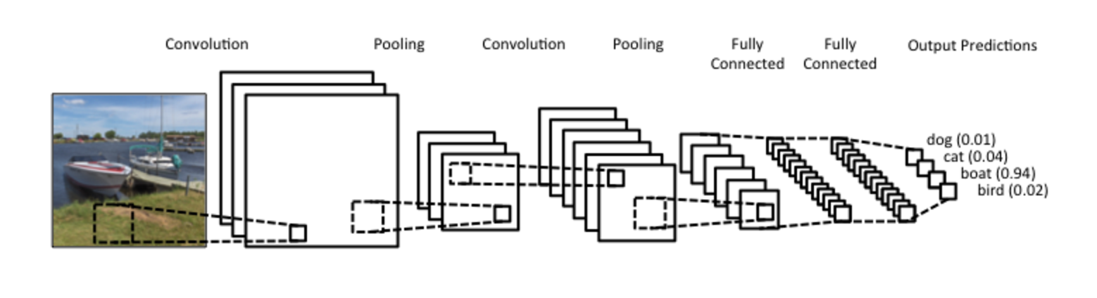
Convolutional Neural Networks
Hierarchical Learning Network
Inspired by Humans

Slide 5
Evolutionary/Swarm-based Algorithms
A process resulting in the improvement of a species over the span of a few generations by adapting and learning from the environment.

Slide 6
Literature Review Description
Paper | Work | Year
ImageNet | Using CNNs on Big Data | 2012
Efficient Parallel Learning Algorithms for Neural Networks | Parallelizable techniques applied to learning in Neural Networks | 1989
Genetic Programming Approach to Designing Neural Network Architectures | Using Cartesian Genetic Programming to encode and generate optimal architectures. | 2017
Large scale evolution of convolutional neural networks using volunteer computing. | Evolving a given architecture and evolving it until optimal results arise using a genetic algorithm. | 2017
Evolving Deep Convolutional Neural Networks by Variable-length Particle Swarm Optimization for Image Classification. | Using Particle swarm optimization with an IP-inspired encoding strategy to find an optimal architecture for a given dataset. | 2018

Slide 7
Our Work
Hybrid Approach Combining All Previously Mentioned Approaches
Improving efficiency by Parallelizing the CNN Evaluation Process
Compare and Contrast
Difference in the Parameters Handled
Parallel Working Efficiency
Related Work | Parameters Tuned
CGP [2] | Activation functions, convolution, pooling
IP.PSO [5] | Convolutional, pooling and fully connected layers, activation functions, kernel sizes, number of neurons.
EXACT [3] | Filter sizes and convolutional layer connections.

Slide 8
Benchmarks
Benchmark Datasets | Benchmarks Neural Nets
CIFAR-10 | Inception V1 (GoogleNet)
ILSVRC-2014 | AlexNet
MNIST | State-of-the-art CNN
Caltech 101 | ResNet

Slide 9
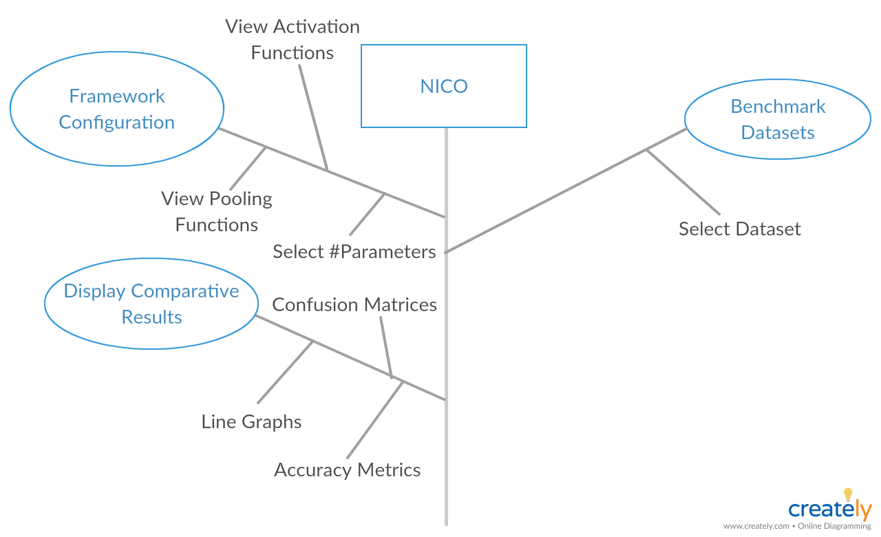

Slide 10
Learning Outcomes
Research & Development
Exposure to deep learning
Exposure to evolutionary algorithms

Slide 11
References
http://deeplearning.net/datasets/ (Benchmark Datasets)
Suganuma, M., Shirakawa, S. and Nagao, T. (2017). A genetic programming approach to designing convolutional neural network architectures. Proceedings of the Genetic and Evolutionary Computation Conference on - GECCO ‘17.
Desell, T. (2017). Large scale evolution of convolutional neural networks using volunteer computing. Proceedings of the Genetic and Evolutionary Computation Conference Companion on - GECCO ‘17.
Krizhevsky, A., Sutskever, I. and Hinton, G. (2017). ImageNet classification with deep convolutional neural networks. Communications of the ACM, 60(6), pp.84-90.
Wang, B., Sun, Y., Xue, B. and Zhang, M. (2018). Evolving Deep Convolutional Neural Networks by Variable-Length Particle Swarm Optimization for Image Classification. 2018 IEEE Congress on Evolutionary Computation (CEC).
Kramer, A. and Sangiovanni-Vincentelli, A. (2019). Efficient Parallel Learning Algorithms for Neural Networks. [online] Papers.nips.cc. Available at: http://papers.nips.cc/paper/134-efficient-parallel-learning-algorithms-for-neural-networks [Accessed 23 Apr. 2019].

